Slide 1
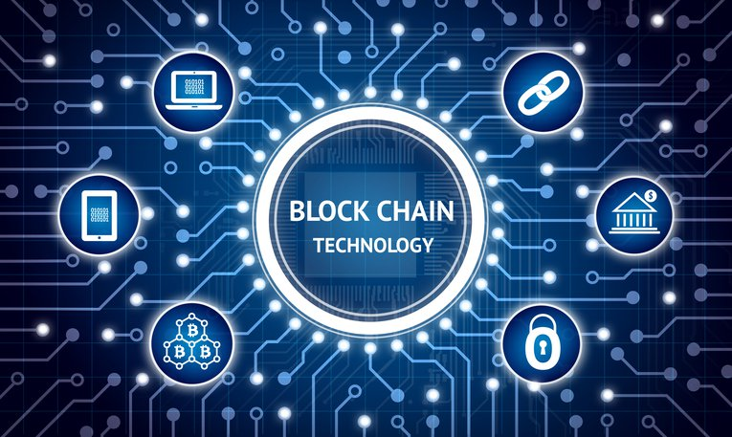
Use cases and challenges Dr. Levi Shaul
Notes:
אני אנסה לארוז את כל מה שהוצג לפני בהיבט
טכנולוגיית הבלוק ציין,
חוזים חכמים שמהווים שכבה לוגית מרחיבה מעל הטכנולוגיה עצמה שמאפשרת לייצר תהליכים רזים ויעלים
להצגת מרחב השימושים תוך כדי ציון של האתגרים העומדים בעת מימוש התהליכים הנ"ל ע"ב טכנולוגיה זו

Slide 2
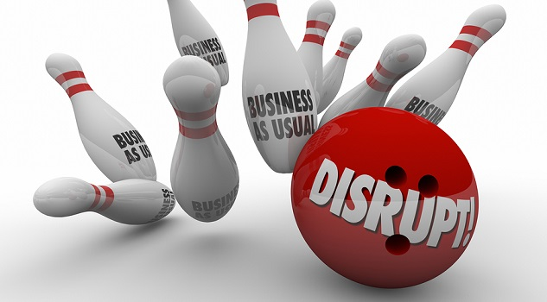
Blockchain ??? WTF ???

Slide 3

Why Blockchain ?

Slide 4
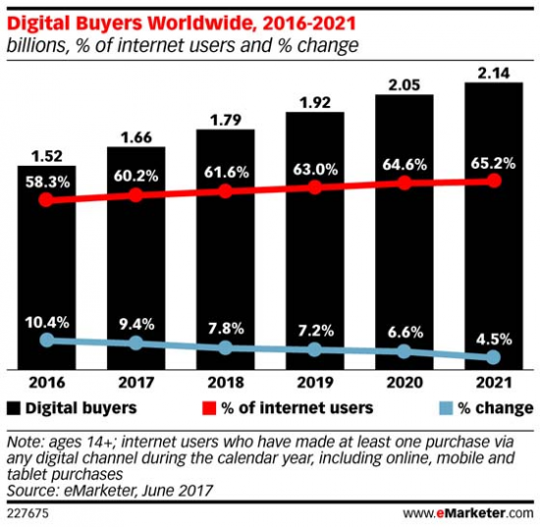
The Digital Age E-Commerce
Notes:
אבל גם בעולם הדיגיטלי אנו תלויים במסגרת מצומצמת יותר של חברות וכאן האפקט הוא אפילו יותר חמור
היקף המכירות ב E_COMMERCE גדל בהתמדה כל הזמן
כולנו מחכים להזמנות מחו"ל זמן רב בשל עומס במכס וברשויות הדואר
אמאזון ואליבאבא מחזיקים ביותר מ 700 מליון קונים בשגרה. אפילו יותר מהרשתות הקמעונאיות הפיזיות

Slide 5
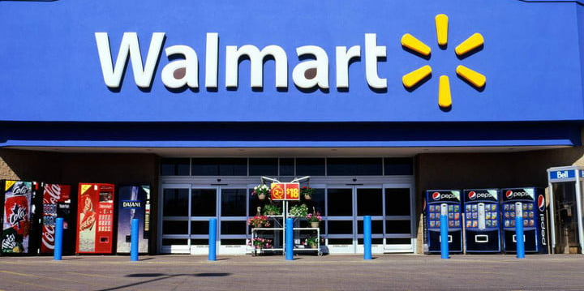
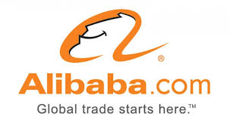

The Digital Age E-Commerce

Slide 6
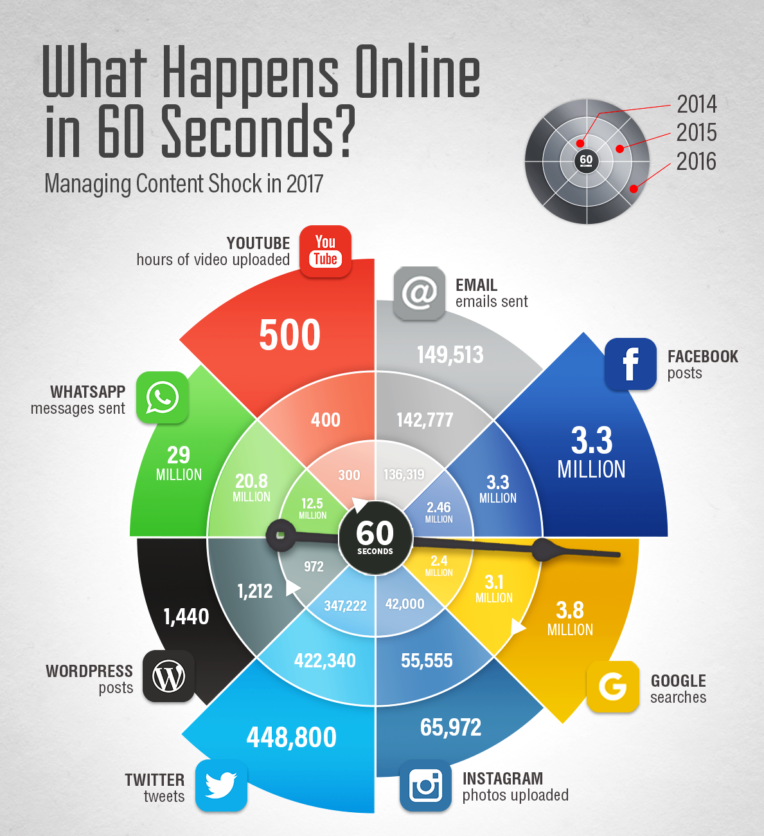

The Digital Age Content Management
Notes:
היקף התוכן המנוהל ברשת הינו עצום
פייסבוק מנהל כ 2.5 מליארד משתמשים מדי חודש כאשר כמעט 2 מליארד מהם נכנסים בכל יום לאפליקציה
פייסבוק רכשו את וואטסאפ ולאחר הרכישה הרשת הזו מהווה פי 6 מהרשת החברתית הבאה אחריה

Slide 7

The Digital Age Search Engines
Notes:
אבא שלי עושה את כל החיפושים בגוגל
80%

Slide 8
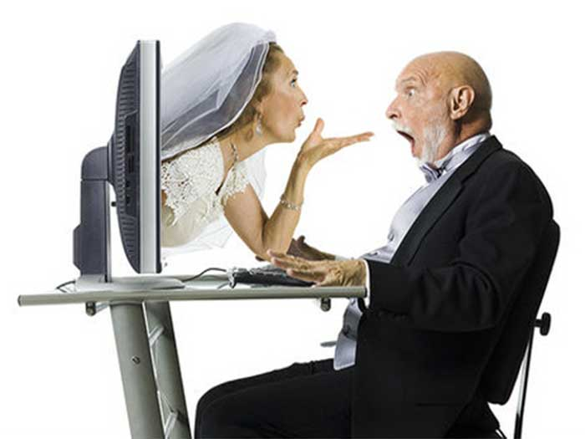
The digital age
Notes:
רק למען הסר ספק - זה לא אבא שלי
אתרי הכרויות
Lovely
BlindDate
Cupid
Jdate
Date4U

Slide 9

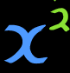
The power of the network
No distance
No effort
Mutual gain (Metklef rule)
Content generated by the users
Notes:
האפליקציות לניהול רשתות חברתיות מתעצמות באופן אקספוננציאלי בריבוע בשל כך שלמשתמשים קל להתאגד תחת ישות אחת בשל:
אי מגבלת מרחק ברשת (זה לא כמו סופרמרקט רחוק-קרוב)
אי מגבלת מאמץ (לא צריך להתאמץ כמו בפתיחת חשבון בנק)
חוק מטקלף - כולם מרוויחים מהשתתפות באותה רשת (משתפים תוכן, ידע כמו וויייז וכו) – הכוח של הרשת הוא ריבוע המשתמשים. משתמשים מביאים איתם עוד משתמשים
משתמשים מייצרים תוכן ולא החברה ולכן אין לחברה אין מאמץ מיוחד ביצירת התשתית השיתופית מעבר לתשתית התקשובית עצמה

Slide 10
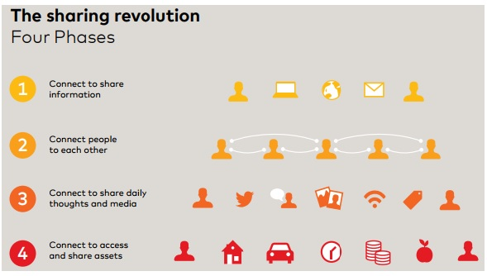
Sharing Economy
Notes:
שיתוף מיילים
צאטים
שיתוף מידע
שיתוף נכסים

Slide 11
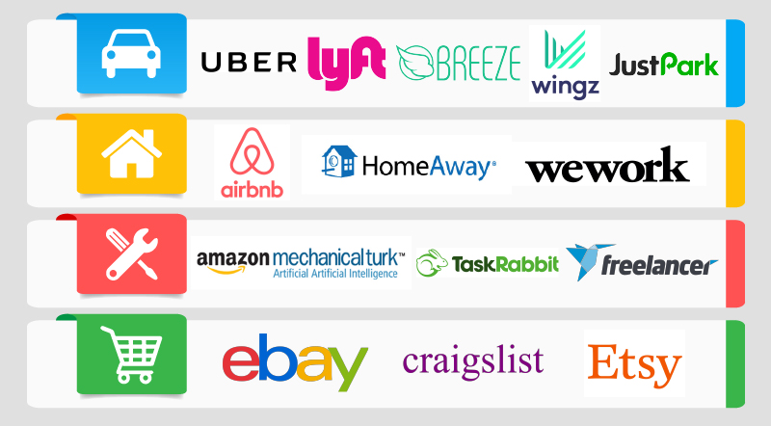
Sharing Economy
Notes:
בסוף גם הכלכלה השיתופית תלויה מאוד במתווך
והמתווך בעולם הדיגיטלי הוא הרבה יותר חזק מחברות בעולם הפיזי

Slide 12
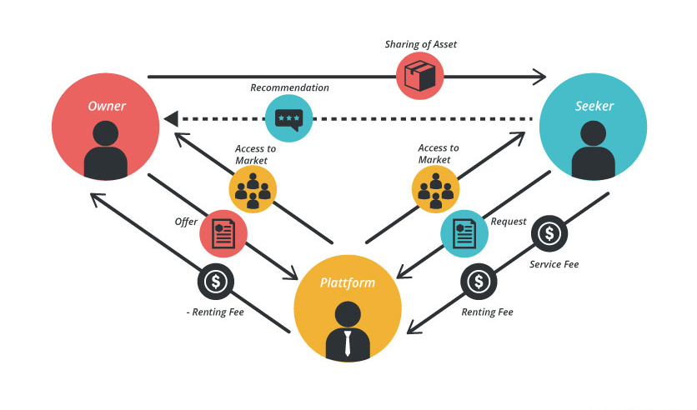
Sharing Economy
Notes:
בסוף גם הכלכלה השיתופית תלויה מאוד במתווך
והמתווך בעולם הדיגיטלי הוא הרבה יותר חזק מחברות בעולם הפיזי

Slide 13

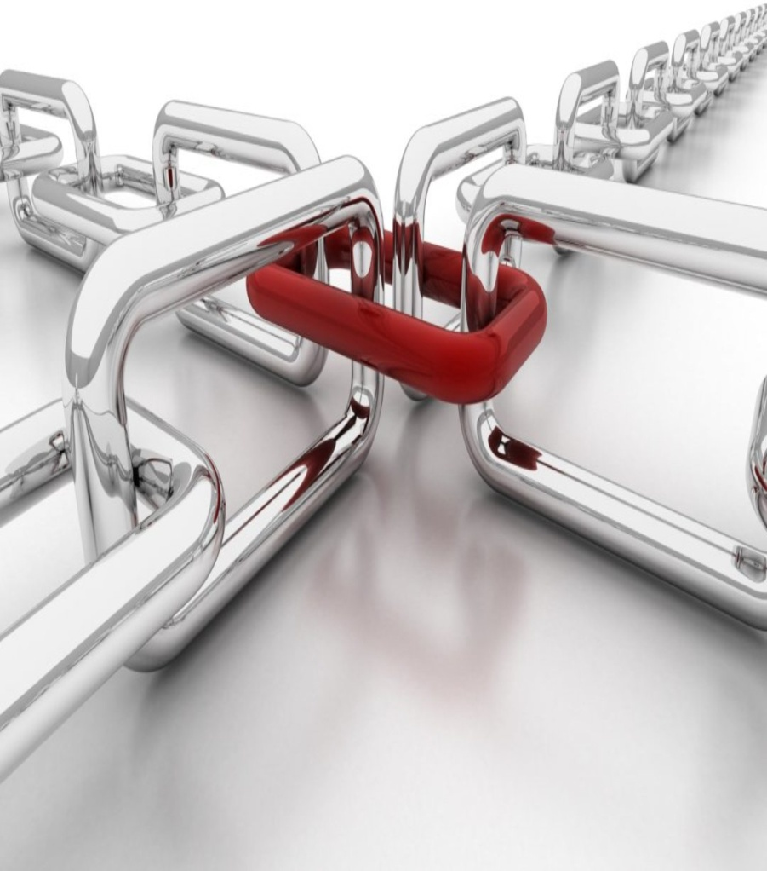
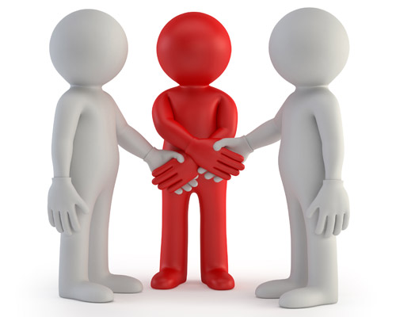
Main Flaws Today
Describing Main flaws:
Mediator
Central Authority
Notes:
Flaws
1/ Single point of failure
2/ Power is centralized
3/ /mediator
We'd be kidding ourselves if we didn't recognize that the vast network of networks didn't have some stubborn problems associated with it.
Beyond some of the obvious, social media trolling, software viruses, online fraud, fake news, and criminal hacking,
the internet often struggles with the fundamental challenges of trust.
We face ongoing questions such as
1/ is the person you are doing business with online really who they say they are?
2/ Is a service real?
3/ And are only authorized people granted access to private systems?

Slide 14
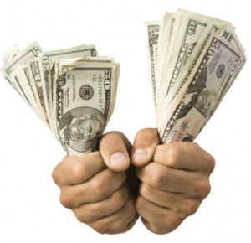
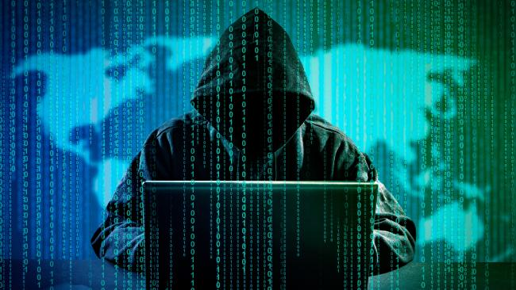
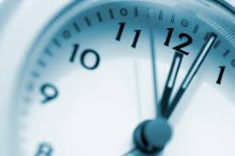
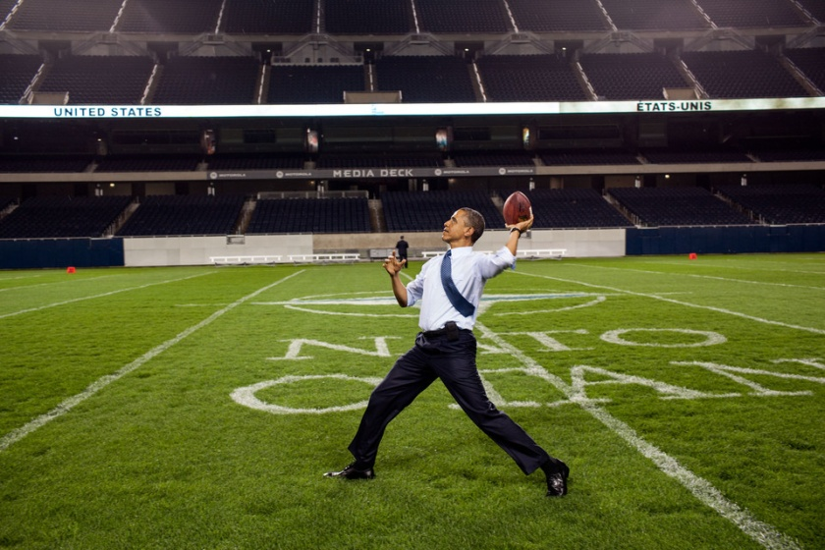
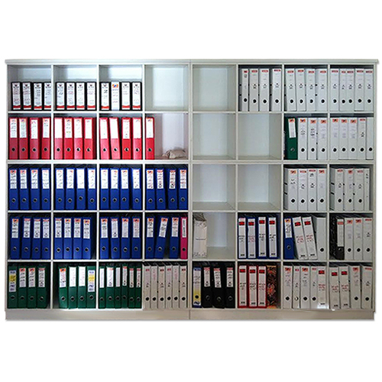

Main Flaws Today
Notes:
Healthy ecosystems rely on trust.
Now, this being said, we've done wonders with existing technology. In addition to usernames and passwords, we now use two-factor authentication,which requires more effort to validate an identity for an individual. For example, after entering a username and password on a laptop computer, a user may be asked to enter another code that is sent separately to the person's mobile phone. We have firewalls and intrusion detection systems, hardware installed for that works to block bad internet traffic, we have biometrics,such as using your fingerprint for access, and CAPTCHAs, those online boxes that require you to type in letters and numbers from a photograph to prove you're not a computer.

Slide 15
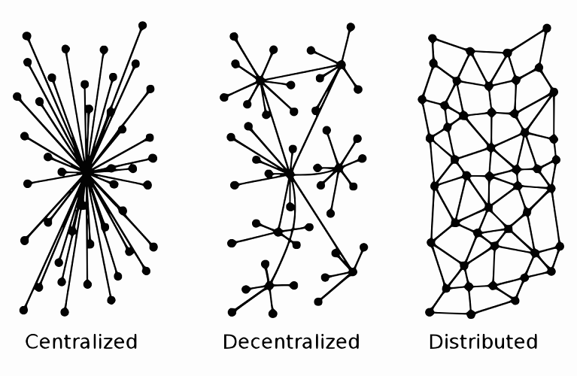
Distributing the Power

Slide 16
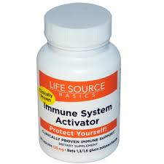
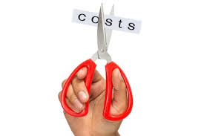
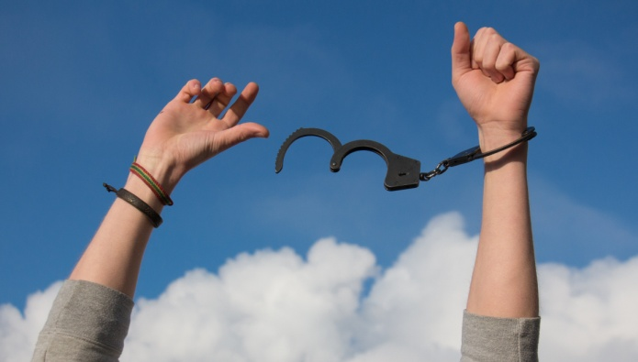
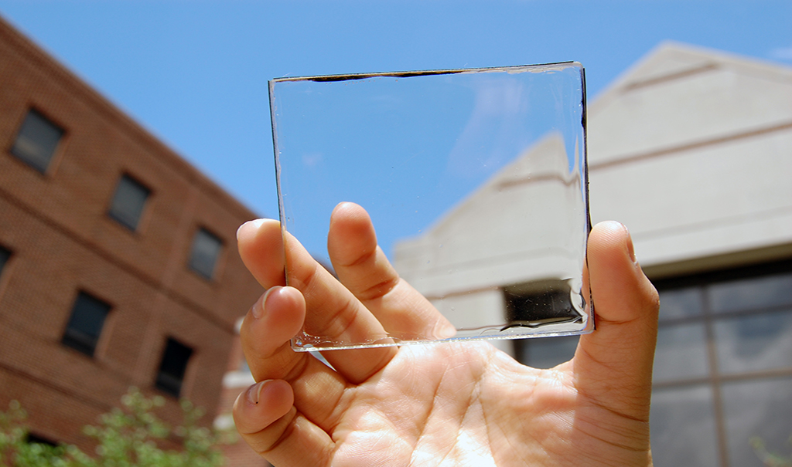
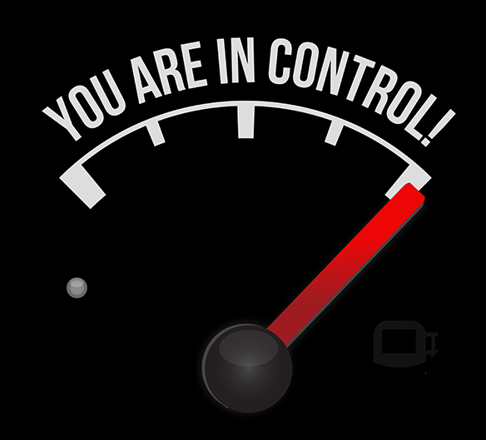
Benefits
Notes:
Payment freedom - It is possible to send and receive any amount of money instantly anywhere in the world at any time. No bank holidays. No borders. No imposed limits. Bitcoin allows its users to be in full control of their money.
- Bitcoin payments are currently processed with either no fees or extremely small fees. Users may include fees with transactions to receive priority processing, which results in faster confirmation of transactions by the network. Additionally, merchant processors exist to assist merchants in processing transactions, converting bitcoins to fiat currency and depositing funds directly into merchants' bank accounts daily. As these services are based on Bitcoin, they can be offered for much lower fees than with PayPal or credit card networks.
Fewer risks for merchants - Bitcoin transactions are secure, irreversible, and do not contain customers’ sensitive or personal information. This protects merchants from losses caused by fraud or fraudulent chargebacks, and there is no need for PCI compliance. Merchants can easily expand to new markets where either credit cards are not available or fraud rates are unacceptably high. The net results are lower fees, larger markets, and fewer administrative costs.
Security and control - Bitcoin users are in full control of their transactions; it is impossible for merchants to force unwanted or unnoticed charges as can happen with other payment methods. Bitcoin payments can be made without personal information tied to the transaction. This offers strong protection against identity theft. Bitcoin users can also protect their money with backup and encryption.
Transparent and neutral - All information concerning the Bitcoin money supply itself is readily available on the block chain for anybody to verify and use in real-time. No individual or organization can control or manipulate the Bitcoin protocol because it is cryptographically secure. This allows the core of Bitcoin to be trusted for being completely neutral, transparent and predictable.

Slide 17
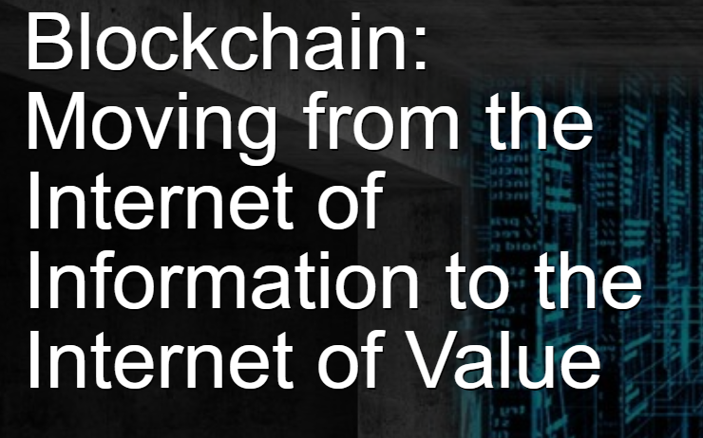
Blockchain - Basics
The blockchain technology is probably the best invention since the internet itself. It allows value exchange without the need for trust or for a central authority

Slide 18
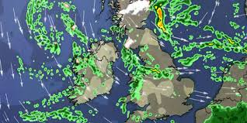
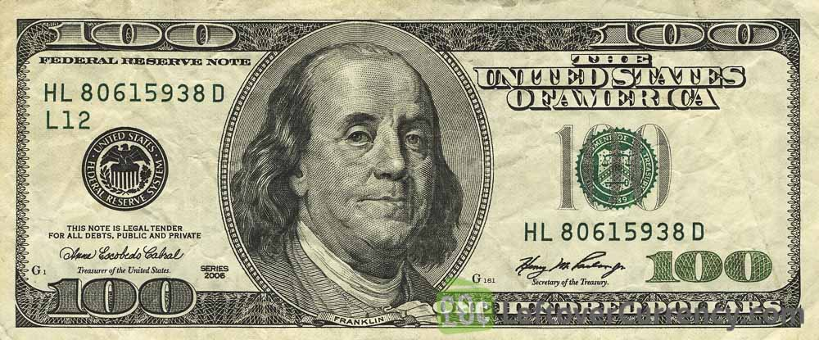

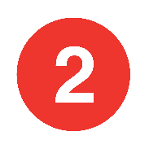
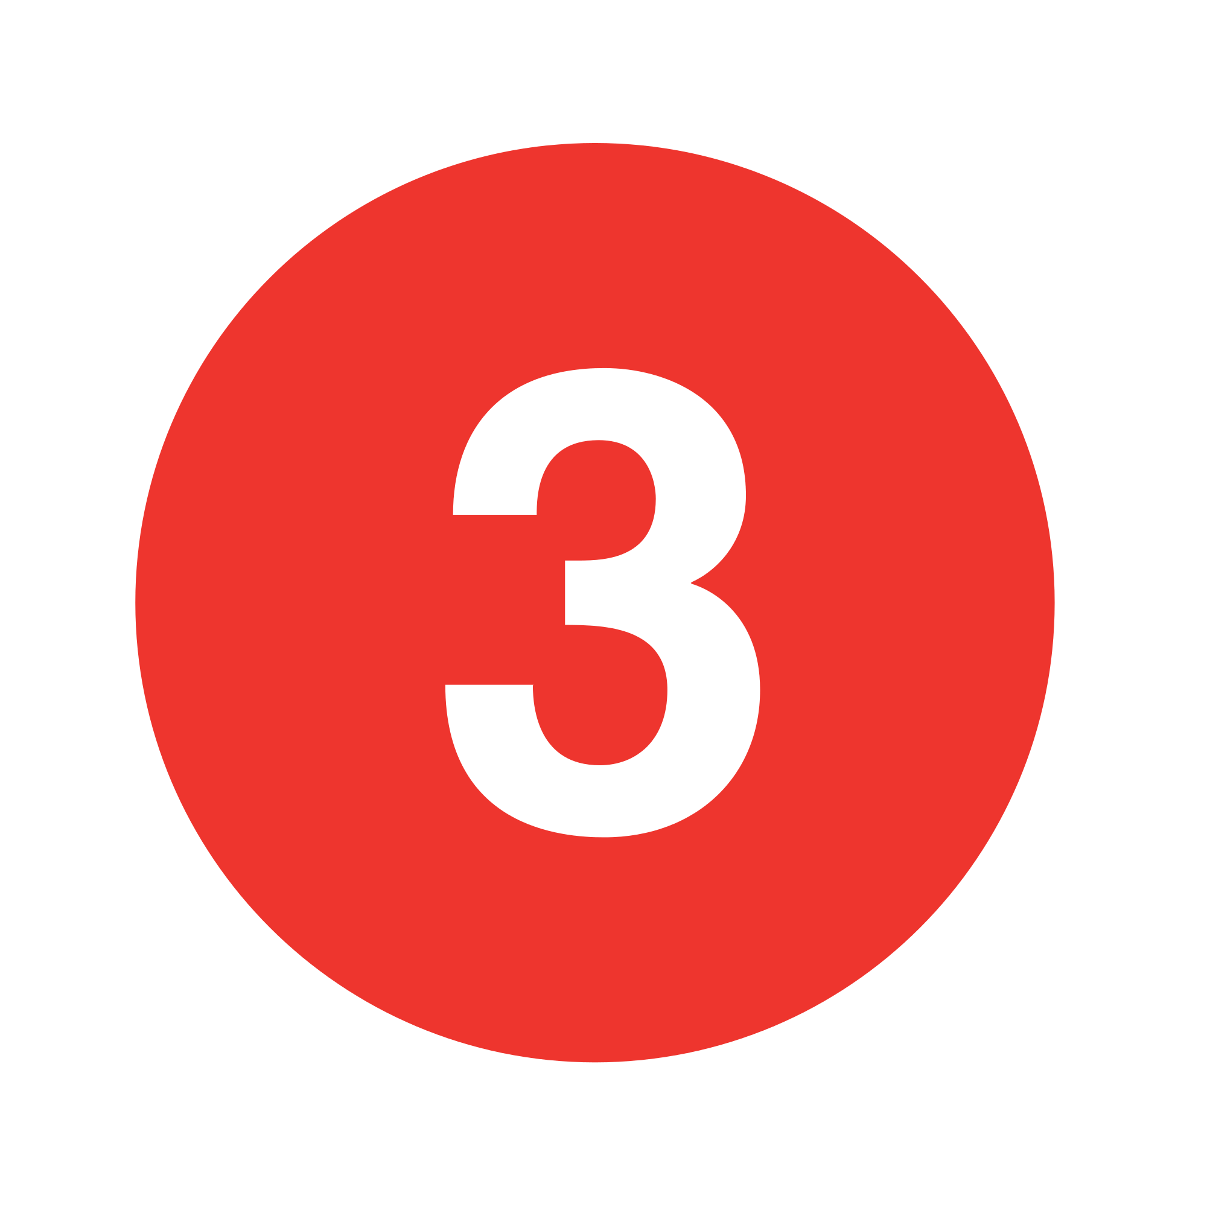
Blockchain - Basics
Definition:
Blockchain allows value exchange (trade) without the need for trust or for a central authority
Notes:
1 - Trust each other
2 - Make a contract
3 – make use of 3rd party

Slide 19
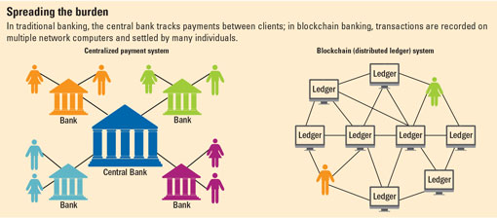

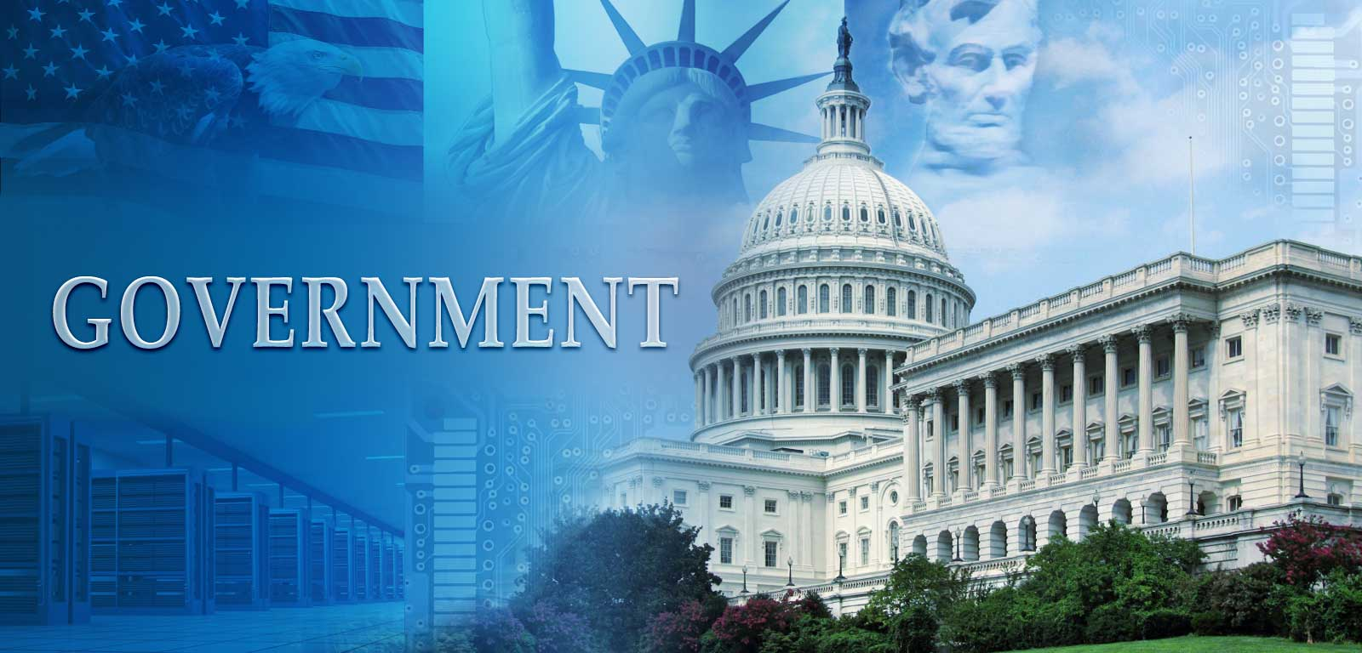
Blockchain - Basics

Slide 20
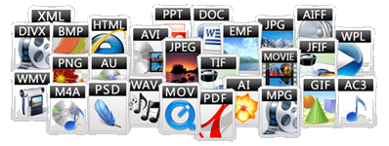
Finance sector only ?
Intangible digital assets

Slide 21
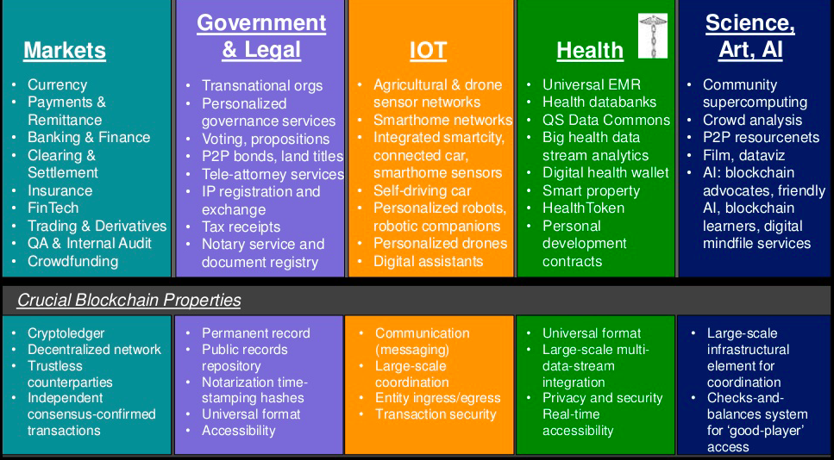
Finance sector only ?
Digital currencies
Loan, Mortgage, Insurance
Certified ownership tangible assets
(house, car, etc.)
Monitor, control and usage of tangible assets
Medical records, analysis and insurance
Intellectual
assets

Slide 22
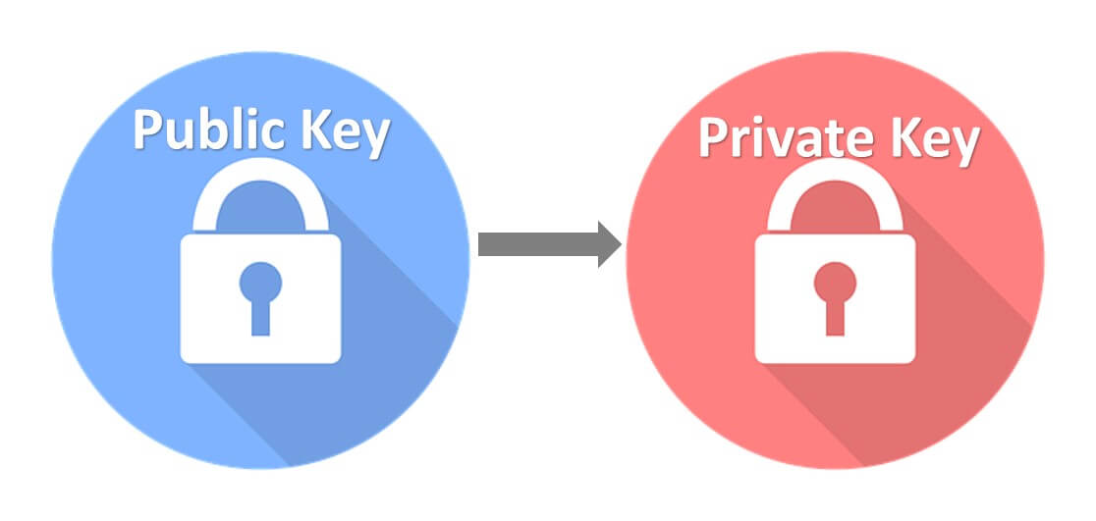
Cryptography (Secret writing in Greek)
Mine
Mine
Generating a key only in one direction

Slide 23


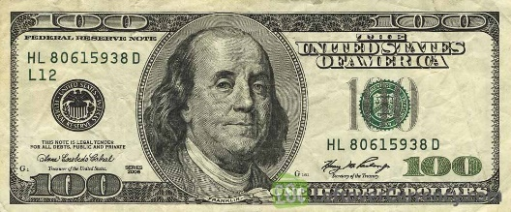
Cryptography (Secret writing in Greek)

Slide 24

Cryptography (Secret writing in Greek)

Slide 25
Nonces, hash functions, and mining
Nonces
A number that is used once and added to a transaction identifier
Used to reduce possibility of duplicated transactions
Mostly important in big data era
Hash function
mathematical process that takes data of any size, performs an operation on it, and returns a hash, which is data of a fixed-size
Allows it only in one direction

Slide 26
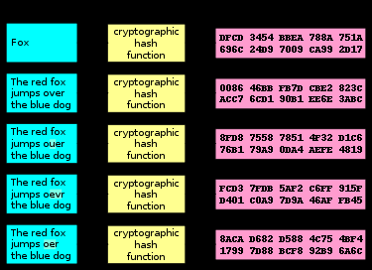
Hash function results for different inputs

Slide 27
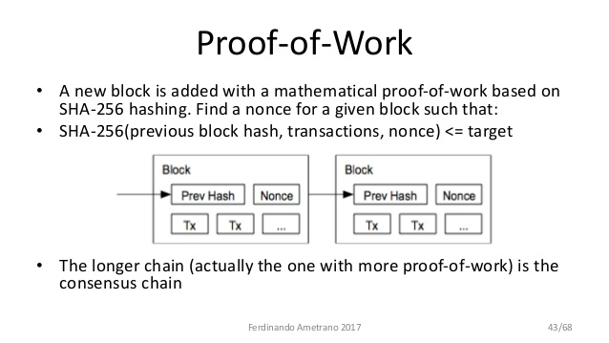
Mining – Proof of work (just like resources to mine gold or diamond)

Slide 28
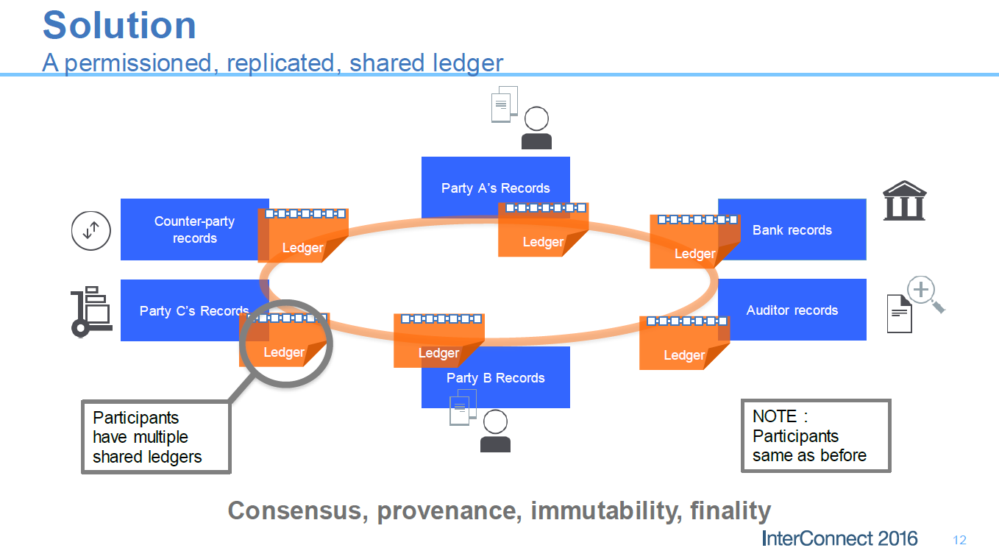
Blockchain P2P Architecture Shared Ledger
No central database
Distributed database technology

Slide 29
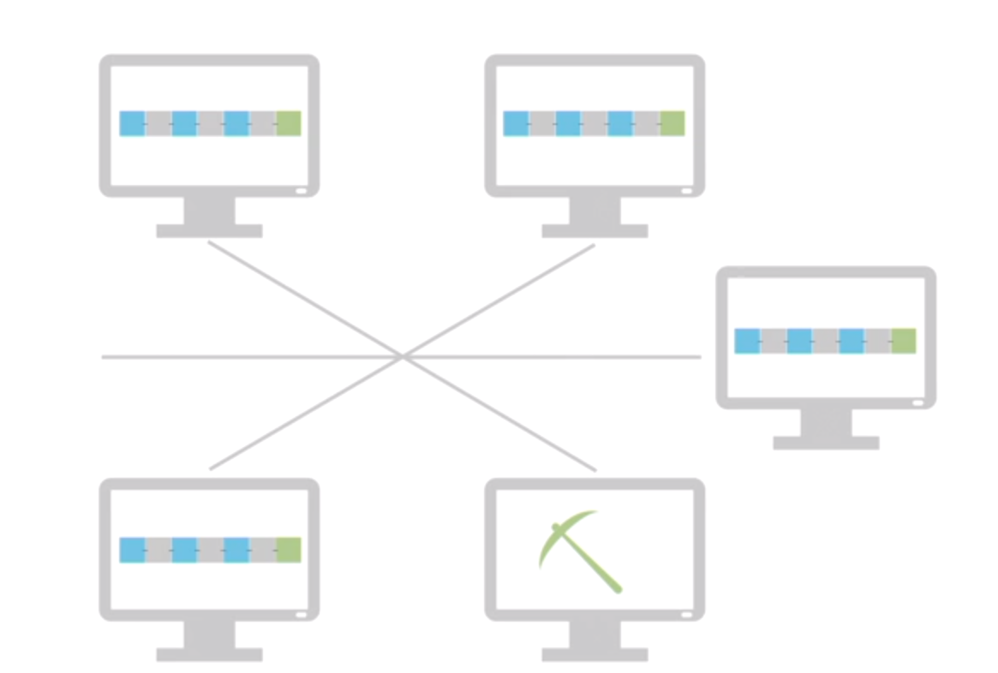
Blockchain P2P Architecture Shared Ledger

Slide 30
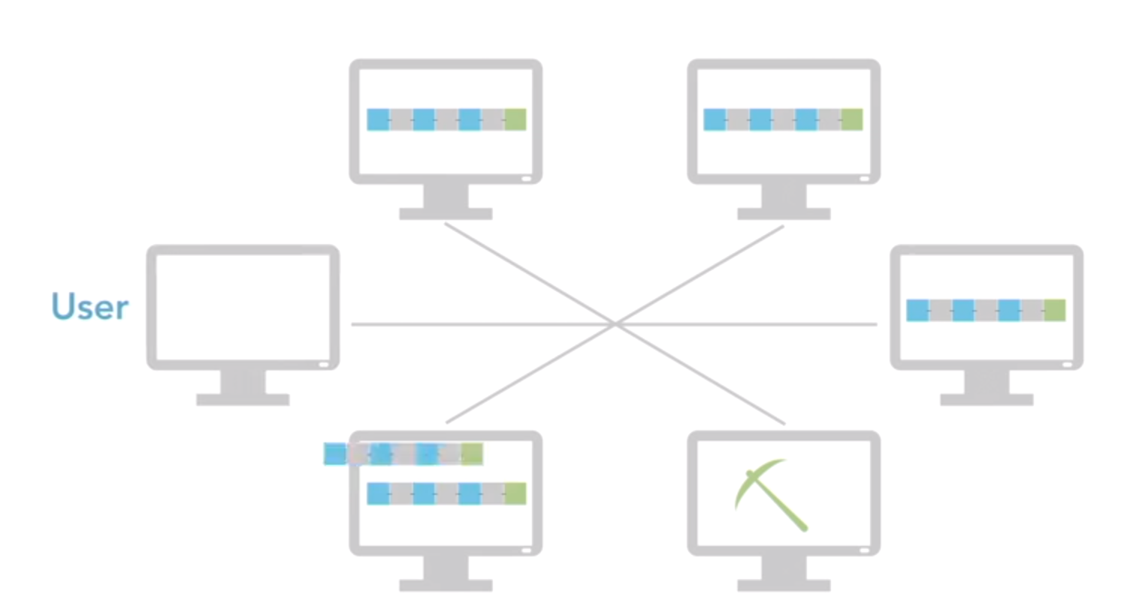
Blockchain P2P Architecture Shared Ledger

Slide 31
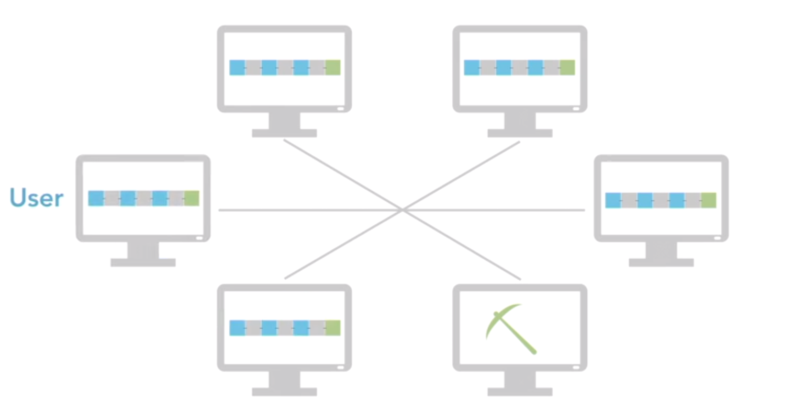
Blockchain P2P Architecture Shared Ledger

Slide 32
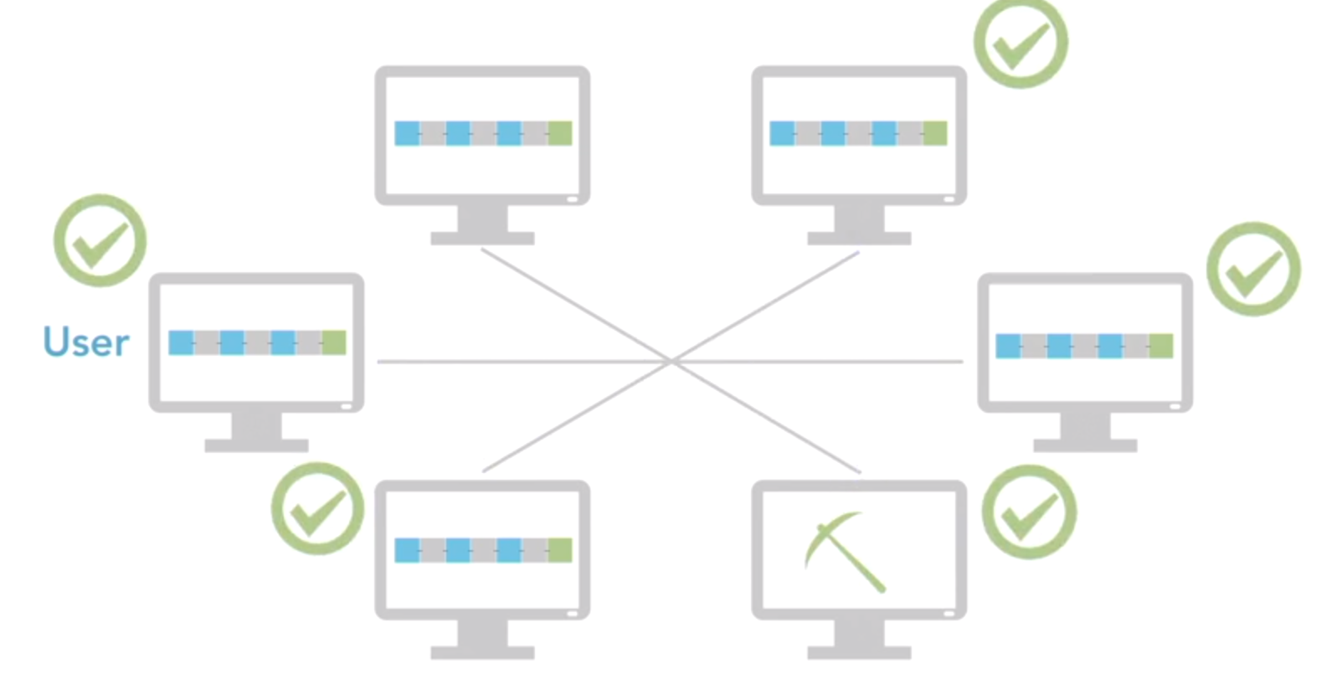
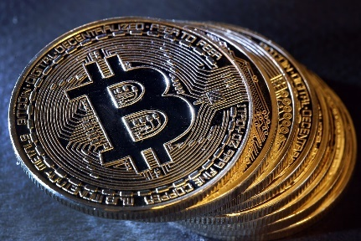
Blockchain P2P Architecture Shared Ledger

Slide 33
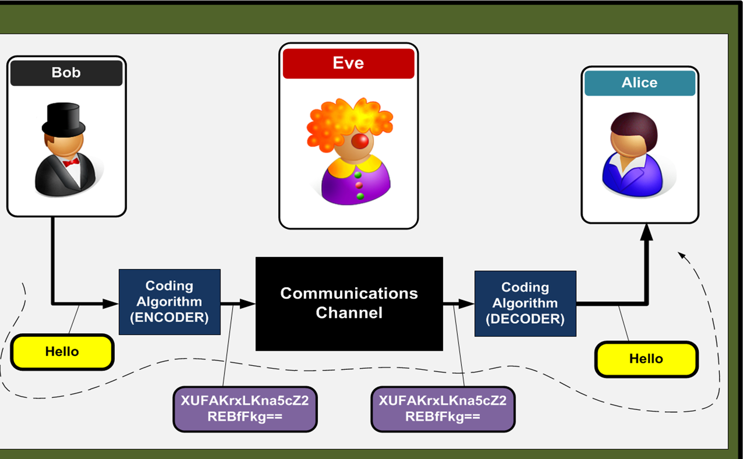
Cryptography (Secret writing in Greek)

Slide 34
Blockchain - Basics

Slide 35
Blockchain - Basics
Hash(G)
Hash(P)
G
P
Q
Q’s parent is P. Each block refers to its parent block
The parent block is the previous block added to the chain
Each block contains the hash of its parent inside its own header (tamper evident)
The genesis block has no parent. It does have 50 bitcoins (initial money supply)
Each block has a proof of work

Slide 36
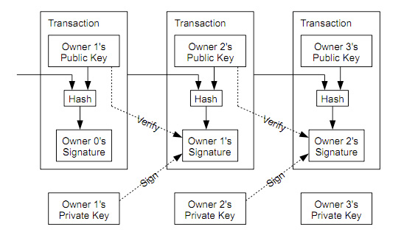
Blockchain - Basics

Slide 37
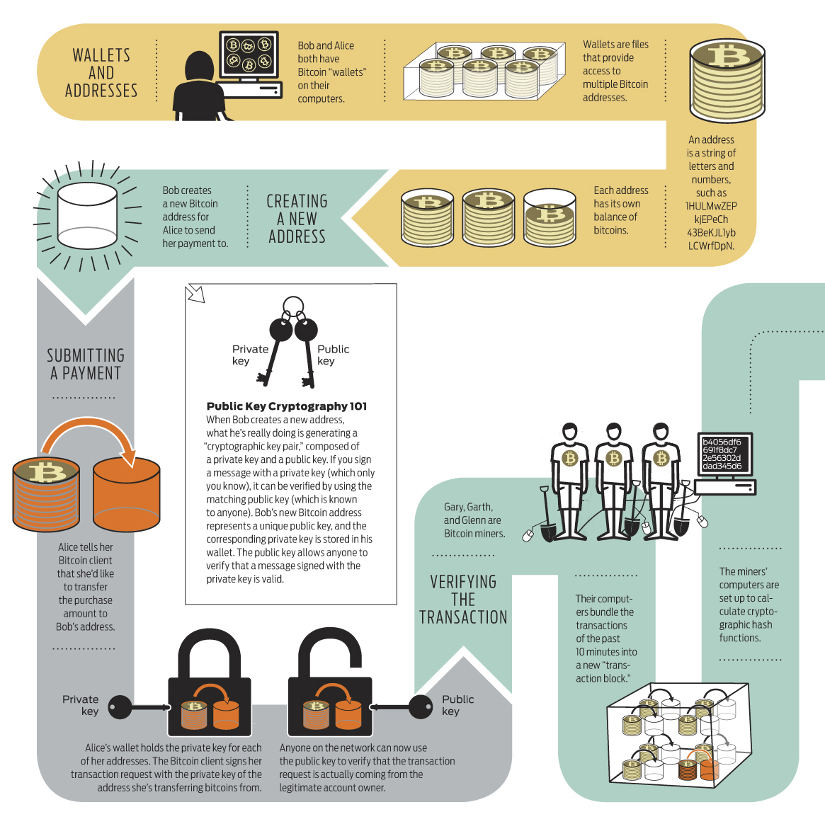
Blockchain - Basics

Slide 38
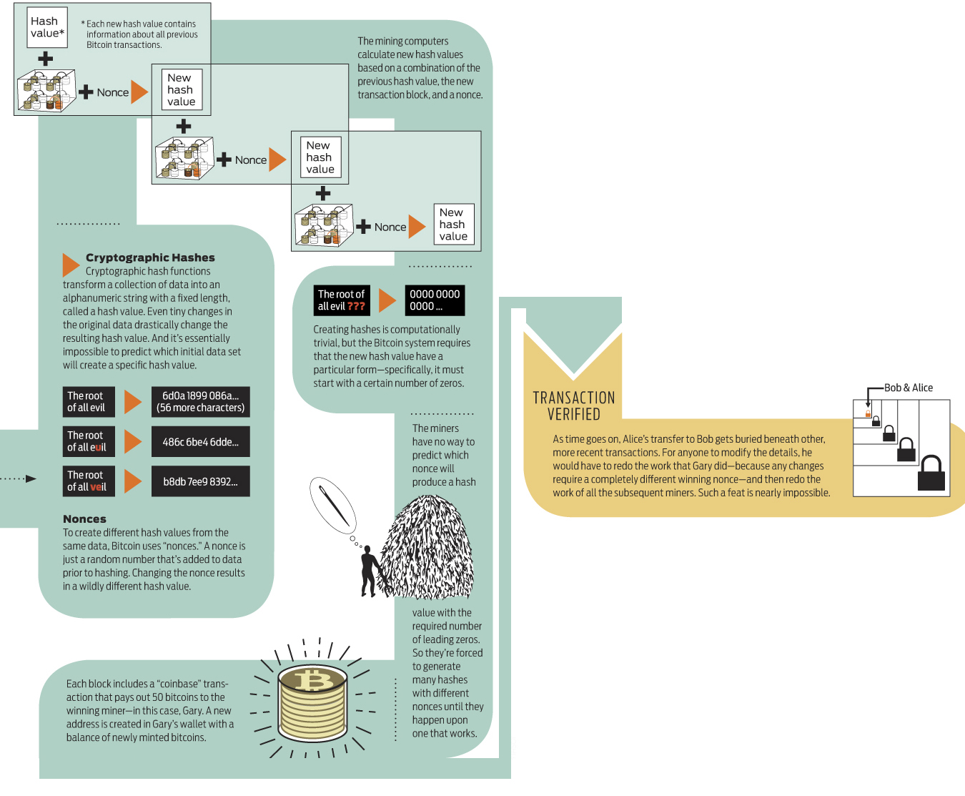
Blockchain - Basics

Slide 39
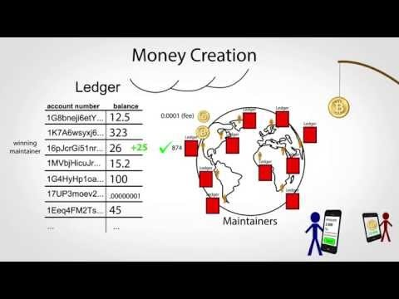
SUMMARY

Slide 40
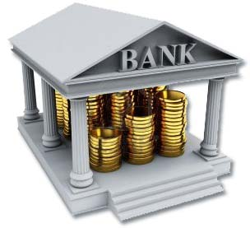
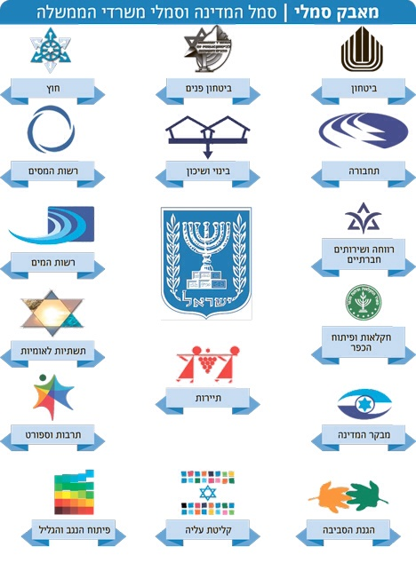



What have we learned so far ? No Trust
Notes:
אנו תלויים במידה רבה במסגרת מצומצמת מאוד של חברות גם בעולם הקמעונאות, הפיננסים וכו'

Slide 41
Main Flaws Today
Describing Main flaws:
Mediator
Central Authority
Notes:
Flaws
1/ Single point of failure
2/ Power is centralized
3/ /mediator
We'd be kidding ourselves if we didn't recognize that the vast network of networks didn't have some stubborn problems associated with it.
Beyond some of the obvious, social media trolling, software viruses, online fraud, fake news, and criminal hacking,
the internet often struggles with the fundamental challenges of trust.
We face ongoing questions such as
1/ is the person you are doing business with online really who they say they are?
2/ Is a service real?
3/ And are only authorized people granted access to private systems?

Slide 42
Blockchain Generations
Address
Public & Private key
Signature
Transaction
Trustworthy Ledger
Cryptocurrency
Trustworthy Contracts
Payments based on events
Decentralized applications
Data
Value
Identity
Computation
Bandwidth
Autonomous agents
Property management
Crowd funding
Notes:
Generation 1.0 - https://www.youtube.com/watch?v=Lx9zgZCMqXE

Slide 43


Smart Money
Notes:
Page 104
Intrinsic value moved to
Government issued fiat money in the form of compact paper notes
Virtual money: SWIFT >> EFT
Digital money: coins and banknotes expected to vanish

Slide 44


Regulations
Notes:
Regulation
In the last decade we witness fundamental changes in the inter-bank exchange and payment infrastructure that are designed to tighten control and transparency.
Many of these changes are fueled by regulatory pressure to mitigate (להקטין) particular security and compliance issues such as money laundering terrorism, corruption as well as to increase competition.
SEPA Single European payment area
PSD2 Payment service directive that forces banks to open up their payment infrastructure to provide 3rd party providers with access to bank accounts and initiate payment
Fintech

Slide 45
Pressures
Financial player
Technology
Regulation
Competition
Seamless process
Smart contract
Notes:
Regulation
In the last decade we witness fundamental changes in the inter-bank exchange and payment infrastructure that are designed to tighten control and transparency.
Many of these changes are fueled by regulatory pressure to mitigate particular security and compliance issues such as money laundering terrorism, corruption and increase competition.
SEPA Single European payment area
PSD2 Payment service directive that forces banks to open up their payment infrastructure to provide 3rd party providers with access to bank accounts and initiate payment
Fintech

Slide 46
Cross-Industry Adoption Sectors leading the way in blockchain implementation
Capital markets
Supply chain
Manufacturing
Health care
Media
Telecommunications

Slide 47

AltCoins
Different monetary policy.
Different proof of work or consensus mechanism
Specific features or focus areas
ICO- issue an initial coin offering (like IPO)
Notes:
It would be easy to conclude that Bitcoin is the only cryptocurrency available. Sure, it's the only one I've discussed so far. In fact, there are many more cryptocurrencies, many that have forked from the original open source Bitcoin code and there are quite a few alternative blockchains. We call these altcoins and altchains, respectively. As of mid-July 2017, there are around 900 cryptocurrencies in circulation. Yes, 900.
ICO - like Initial public offering – קניית בעלות
Challenge -The US securities and exchange commission, the SCC, who are responsible for such things, are engaged in the topic, particularly to determine whether the tokens offered in an ICO are considered a security.
Until there are formal rulings ICOs will continue in the legal gaps that exist.
Until now only China and South Korea have made ICOs illegal

Slide 48


AltChain
 | Liquid Blockchain | Bitcoin Blockchain
Global | √ | √
Secure | √ | √
Reliable settlement | √ | √
Rapid transfer and settlement | Minutes | Hours
Privacy | Private | Public
Notes:
As a result, alternative blockchains or altchains have emerged. At a basic level, altchains support altcoins, so we can consider them hand in hand. However, many altcoins do use the Bitcoin blockchain. Altchains do provide us with some opportunities.
1/ they are perfect for experimentation. This supports learning and testing.
2/ altchains can be tuned for particular uses. For example, liquid is a sidechain, an altchain that is pegged to the Bitcoin blockchain and it's designed to facilitate rapid transfers among a small number of Bitcoin exchanges and brokers. It avoids latencies of conducting transactions on the core Bitcoin blockchain. Three, an altchain may be used to exercise greater control over Bitcoin transactions. It could, for example, require proof that a wallet is owned by a verified institution before allowing it to receive funds.
And finally, four, an altchain can be used to provide privacy that goes above and beyond those inherent to Bitcoin. For example, transactions could be hidden from public view to prevent discovery of trade secrets.

Slide 49
Private Blockchain
functionality | Public blockchain | Private blockchain
Join | √ Everyone | √ Selective
Inspect | √ Everyone | √ Selective
Digital signature | √ | √
Confidentiality | X | √

Slide 50

Challenges - Privacy

Slide 51

Challenges - Privacy

Slide 52





Challenges
Notes:
ICOs, which have shown so much promise for fundraising may
1/ not survive future regulation
2/ or at best, might be constrained in their optimal potential.
3/ the rigor and trust of Bitcoin and Ethereum will likely dominate.
Scalability is japardise because every peer needs to
1/ run every transaction
2/ maintain the ledger
3/ run consensus

Slide 53
Blockchain Generations
Address
Public & Private key
Signature
Transaction
Trustworthy Ledger
Cryptocurrency
Trustworthy Contracts
Payments based on events
Crowd funding
Decentralized applications
Data
Value
Identity
Computation
Bandwidth
Autonomous agents
Property management

Slide 54

Smart Contract

Slide 55

Smart Contract more than merely monetary value

Slide 56

Smart Contract

Slide 57

Parental Authority
Notes:
יוזף
פרנץ ואווה

Slide 58

Parental Authority
Food
Cloths
Entertainment
other needs
Notes:
Only vegetarian food at school, no alcohol
New pair of jeans and nothing else
Entertainment – up to some limit

Slide 59



Old Idea
Notes:
המדינה היא ההורים

Slide 60

Parental Authority

Slide 61




Value systems of users
Notes:
אחת הדרכים כדי לקדם את הקליטה של רעיון הכסף החכם הוא ע"י קידום אגנדות שחשובות לציבור

Slide 62

Different Perspectives
Notes:
לא תמיד קל לייצר הסכמה על תנאי החוזה
Public debate concerning technical, organizational, social and ethical issues

Slide 63

Late Adopters
Notes:
כסף חכם ייעשה שימוש גם באמצעות ממשלות, ארגונים פיננסיים, ארגונים עסקיים, סוכנויות, סוחרים, פוליטיקאים, ציבור וכו' ולכן מעורבים שחקנים רבים באירוע. לשחקנים אלו יש מקום שונה בעקומת הקליטה.
צריך לדעת לתת מענה למגוון אנשים שונים כי הקליטה של היכולות נעשית בנק' שונות – נדרש לתמוך בתהליך חדש במקביל לתמיכה ב LEGACY
טרם ברור מה מידת האמון שכל קבוצה תייצר אל מול הטכנולוגיה החדשה

Slide 64
Blockchain Generations
Address
Public & Private key
Signature
Transaction
Trustworthy Ledger
Cryptocurrency
Trustworthy Contracts
Payments based on events
Crowd funding
Decentralized applications
Data
Value
Identity
Computation
Bandwidth
Autonomous agents
Property management

Slide 65

Retirement

Slide 66
Autonomous Pension Funds on Blockchain
Contracts with customers
Receive stream of payments
Pay a stream of benefits to retires/disabled
Send forecast of future benefits
Invest and manage net assets
Report to regulators to show sufficient assets
Pay taxes
React to life events (retirement/disability/death)

Slide 67
Autonomous Pension Funds on Blockchain
Contracts with customers
Receive stream of payments
Pay a stream of benefits to retires/disabled
Send forecast of future benefits
Invest and manage net assets
Report to regulators to show sufficient assets
Pay taxes
React to life events (retirement/disability/death)
Notes:
Mainly processing of contract regulated payment and seem clearly implementable using self executing contract and cryptocurrency

Slide 68
Autonomous Pension Funds on Blockchain
Contracts with customers
Receive stream of payments
Pay a stream of benefits to retires/disabled
Send forecast of future benefits
Invest and manage net assets
Report to regulators to show sufficient assets
Pay taxes
React to life events (retirement/disability/death)
Notes:
Can be based on the highly on developed actuarial mathematics in the scandinavian/german tradition formalized with stochasic state models

Slide 69
Autonomous Pension Funds on Blockchain
Contracts with customers
Receive stream of payments
Pay a stream of benefits to retires/disabled
Send forecast of future benefits
Invest and manage net assets
Report to regulators to show sufficient assets
Pay taxes
React to life events (retirement/disabilty/death)
Notes:
DAO

Slide 70
Autonomous Pension Funds on Blockchain
Contracts with customers
Receive stream of payments
Pay a stream of benefits to retires/disabled
Send forecast of future benefits
Invest and manage net assets
Report to regulators to show sufficient assets
Pay taxes
React to life events (retirement/disability/death)
Notes:
It depends on insurance related life status and events being reported in trustworthy and automated way so that self executing contract can act on them

Slide 71
Autonomous Pension Funds on Blockchain
Contracts with customers (domain specific language)
Receive stream of payments
Pay a stream of benefits to retires/disabled
Send forecast of future benefits
Invest and manage net assets
Report to regulators to show sufficient assets
Pay taxes
React to life events (retirement/disability/death)
Notes:
Can be performed in a domain specific language that is then used in constraining the investment decisions (e) so the asset composition matches the expected obligation
יכול להיות בין מדינתי ולא רק לוקאלי למדינה מסוימת

Slide 72


Challenges – Damage Assessment

Slide 73


Challenges – Long Term Obligation
Notes:
בת 25 תפרוש בשנת 2060 וצפויה לקבל תשלומים עד 2085 או אפילו יותר
איזו סיבה יש לה לסמוך על קרן פנסיה אוטונומית שתעמוד בכלל ההתחייבויות שהוזכרו לעיל ?
ברור שרגולציה ממשלתית חייבת להתקיים כמו גם אמון בטכנולוגיה כדי לקיים את היכולת הזו
קרנות פנסיה בעולם עומדות בתנאי רגולציה גם של המדינה עצמה וגם של הקהילה הבין לאומית (למשל איחוד אירופי) כדי לוודא יכולת מענה לצורך בהמשך קיום של הפרט בעת פרישה

Slide 74
Challenges - Certified by Regulators
Notes:
קרנות פנסיה בעולם עומדות בתנאי רגולציה גם של המדינה עצמה וגם של הקהילה הבין לאומית (למשל איחוד אירופי) כדי לוודא יכולת מענה לצורך בהמשך קיום של הפרט בעת פרישה
לכן קרנות הפנסיה האוטנומיות חייבות להיות CERTIFIED BY THE GOVERNMENT

Slide 75

Accounting Industry

Slide 76

Intermodal Transportation
Notes:
Complex and fragmented industry
21413 TEU - twenty-foot equivalent unit – 20feet container

Slide 77

Intermodal Transportation

Slide 78

Very Complex Industry
Notes:
Intermodal transportation is a complex and fragmented industry

Slide 79

International Trade
Agreement
Transportation
Notes:
http://slideplayer.com/slide/5803386/
International trade is the exchange of goods and services across international boundaries or territories. I
While international trade has been present throughout much of history its economic, social, and political importance has been on the rise in recent centuries due to
1/ Industrialization,
2/ advanced transportation,
3/ globalization,
4/ multinational corporations, and
5/ outsourcing
are all having a major impact.
Increasing international trade is basic to globalization

Slide 80
LOC - a Letter of Credit
A payment undertaking
given by a bank (issuing bank)
On behalf of a buyer (applicant)
To pay a seller (beneficiary)
for a given amount of money
On presentation of specified documents representing the supply of goods
Notes:
World exports of goods and services reached nearly 24USD trillion in 2016 between unknown and untrusted 3rd parties
זה מנוע צמיחה מרכזי לכל מדינה שחפצה חיים

Slide 81

LOC - a Letter of Credit Transaction Process Flow
Notes:
Letters of credit deal in documents, not goods.
כל התייעלות בתהליך תשפר משמעותית את הביצועים העסקיים וכפועל יוצא גם את הכלכלה המקומית והעולמית
The issuing bank's liability to pay and to be reimbursed from its customer becomes absolute upon the completion of the terms and conditions of the letter of credit. Under the provisions of the Uniform Customs and Practice for Documentary Credits, the bank is given a reasonable amount of time after receipt of the documents to honor the draft.
11 The issuing banks' role is to provide a guarantee to the seller that if compliant documents are presented, the bank will pay the seller the amount due and to examine the documents, and only pay if these documents comply with the terms and conditions set out in the letter of credit.
12 Typically the documents requested will include a commercial invoice, a transport document such as a bill of lading or airway bill and an insurance document; but there are many others.

Slide 82

BOL –Bill of Landing Transaction Process Flow
Notes:
https://transportgeography.org/?page_id=8517
https://transportgeography.org/?page_id=1768
סנכרון מידע קריטי בעיקר כאשר יש תקלות/עיכובים

Slide 83

LOC / BOL

Slide 84



Notes:
The more are involved into the process the less inter-organizational trust exists
They are
1/ based in different countries
2/ different legal systems
3/ working partners are changed often

Slide 85
Blockchain in favor of Intermodal Transportation
Current and up to date status
Route history
Overall documentation
Comprehensive picture

Slide 86

Challenges - Certified by Regulators
Notes:
קרנות פנסיה בעולם עומדות בתנאי רגולציה גם של המדינה עצמה וגם של הקהילה הבין לאומית (למשל איחוד אירופי) כדי לוודא יכולת מענה לצורך בהמשך קיום של הפרט בעת פרישה
לכן קרנות הפנסיה האוטנומיות חייבות להיות CERTIFIED BY THE GOVERNMENT

Slide 87
Challenges in Intermodal Transportation Industry
Companies - Open up their data
IT
Requires ERP-Blockchain standardization
Requires hardware solution integration to follow freights in real time
Record liability requires trust and security between all participants

Slide 88

Energy sector
SolarCoin blockchain
Notes:
Today, its a complex ecosystem that requires extensive trust and intermediaries.
At a basic level, blockchain technology seems well suited to securely recording and storing transactions and thus increasing integrity and trust. In addition, an energy blockchain could provide secure storage of ownership records, in particular in the field of energy certification.
Here are three use cases for the field of energy certification.
1/ First is the verification of renewable electricity and of emission allowances.
2/ register records and regulates the ownership and current state of assets such as smart meters, networks, and generation facilities
3/ smart meter data could be shared with a wide variety of consumers without compromising privacy or security
Energy billing
Traditionally, there are major energy producers who provide energy either carbon or non-carbon based directly to customers or through a distribution provider, but this model which hasn't changed in decades has the potential for future disruption.
In particular, when industries and homeowners begin to produce their own power using solar and wind for example, a marketplace where the consumer also becomes the producer is well within the realm of possibility in just a few years. The potential trading and interactions between players becomes very interesting indeed. Let's assume that an entire sizable neighborhood of homeowners generates their own power. This neighborhood has microclimates so sometimes one side of the neighborhood is cloudy while the other side is sunny.
A great way to facilitate this will be to use a blockchain that uses smart contracts to manage the energy trades. Over time, homeowners would accumulate cryptocurrency that could be converted to say dollars or could be used to directly purchase products. Several companies are already developing and testing this technology.

Slide 89
Energy sector
SolarCoin blockchain
Energy certification
Verification of renewable electricity and of emission allowances.
Register records and regulates the ownership and current state of assets (smart meters, networks, generation facilities)
Share with a wide variety of consumers without compromising privacy or security
Energy billing
The consumer also becomes the producer
The potential trading and interactions between players becomes very relevant.
Sharing economy in energy
Notes:
Today, its a complex ecosystem that requires extensive trust and intermediaries.
At a basic level, blockchain technology seems well suited to securely recording and storing transactions and thus increasing integrity and trust. In addition, an energy blockchain could provide secure storage of ownership records, in particular in the field of energy certification.
Here are three use cases for the field of energy certification.
1/ First is the verification of renewable electricity and of emission allowances.
2/ register records and regulates the ownership and current state of assets such as smart meters, networks, and generation facilities
3/ smart meter data could be shared with a wide variety of consumers without compromising privacy or security
Energy billing
Traditionally, there are major energy producers who provide energy either carbon or non-carbon based directly to customers or through a distribution provider, but this model which hasn't changed in decades has the potential for future disruption.
In particular, when industries and homeowners begin to produce their own power using solar and wind for example, a marketplace where the consumer also becomes the producer is well within the realm of possibility in just a few years. The potential trading and interactions between players becomes very interesting indeed. Let's assume that an entire sizable neighborhood of homeowners generates their own power. This neighborhood has microclimates so sometimes one side of the neighborhood is cloudy while the other side is sunny.
A great way to facilitate this will be to use a blockchain that uses smart contracts to manage the energy trades. Over time, homeowners would accumulate cryptocurrency that could be converted to say dollars or could be used to directly purchase products. Several companies are already developing and testing this technology.

Slide 90

Identity Management
Notes:
© Elliott Davis Decosimo, LLC © Elliott Davis Decosimo, PLLC
Areas impacted include , e-residency, birth certificates, wedding certificates, IDs, online account logins, etc
“21 Companies Leveraging Blockchain for Identity Management and Authentication” by Elena Mesropyan,
https://letstalkpayments.com/22-companies-leveraging-blockchain-for-identity-management-and-authentication/
Estonia’s ID card can be used, for instance, as a national health insurance card, proof of identification when logging into bank accounts at home and for digital signatures, Today Online adds. Also, the Estonians can vote online using their secure ID cards

Slide 91

Identity Management
Notes:
אמנם ישראל מובילה על המדינה הקטנה שגובלת ברוסיה בכמות המיזמים שנולדים ובמספר הסטארט-אפים שעושים אקזיט, אבל ככל שמדובר בשירותים לאזרח - ישראלי שמגיע לאסטוניה עשוי להרגיש כאילו הגיע מאומה מאותגרת טכנולוגית בעולם השלישי למדינה מתקדמת שבה השירותים הממשלתיים מנוהלים כמו שצריך. מערכת המשפט, מערכת המיסוי, הבנקאות, האנרגיה, הבריאות, התחבורה, הביטוח, מערכת הבחירות ועוד - כולם מנוהלים ברשת וזמינים לאזרחים. כך, האזרח האסטוני לא צריך לבזבז ימי עבודה על סידורים. הוא לא אמור לשלם לעורכי דין ולנוטריונים, ולא צריך לשלוח עותקים נאמנים למקור לשום גורם.
© Elliott Davis Decosimo, LLC © Elliott Davis Decosimo, PLLC
https://www.themarker.com/markerweek/markerweek2013/1.2530777
“21 Companies Leveraging Blockchain for Identity Management and Authentication” by Elena Mesropyan, https://letstalkpayments.com/22-companies-leveraging-blockchain-for-identity-management-and-authentication/
Estonia’s ID card can be used, for instance, as a national health insurance card, proof of identification when logging into bank accounts at home and for digital signatures, Today Online adds. Also, the Estonians can vote online using their secure ID cards

Slide 92

Identity Management
Notes:
The IT audit is broadly concerned with identity management concerns.
Protecting access to data, and the systems that are in place to process, store, and report on that data, requires ongoing resource dedication.
Multiple solutions are available, all of which require configuring and managing multiple identifiers for an individual’s various identities.
Identity management is an area that will certainly be impacted by widespread use of private keys to secure transactions.

Slide 93
Identity Management
Creating an identity on blockchain can give individuals greater control over who has their personal information and how they access it
Digital ID’s can provide digital watermarks that can be assigned to every online transaction of any asset

Slide 94

DAO Organizations

Slide 95
DAO Organizations

Slide 96

Challenges – DAO

Slide 97

Smart contracts Simple to complex

Slide 98



Community
Notes:
Hyperledger is an open source collaborative effort created to advance cross-industry blockchain technologies.
It is a global collaboration, hosted by The Linux Foundation, including leaders in
Finance
Banking
IoT
supply chain
manufacturing, and technology.
Business Blockchain Frameworks are hosted with Hyperledger.
Hyperledger addresses important features for a cross-industry open standard for distributed ledgers. The Linux Foundation hosts Hyperledger as a Collaborative Project under the foundation.
To learn more, visit: https://www.hyperledger.org/.

Slide 99
Hyperledger
Hyperledger is an open source collaborative effort created to advance blockchain technologie.
Hyperledger addresses important features for a cross-industry open standard for distributed ledgers.
It is a global collaboration, hosted by The Linux Foundation, including leaders in
Finance
Banking
IoT
supply chain
Manufacturing
technology.
Business Blockchain Frameworks are hosted with Hyperledger.

Slide 100
Hyperledger Projects
Burrow – Permissible smart contract machine with a modular blockchain client, built in part to the specification of the Ethereum Virtual Machine (EVM)
Iroha – Simple and easy blockchain framework designed to be incorporated into infrastructure projects requiring distributed ledger technology
Sawtooth – A modular platform for building, deploying, and running distributed ledgers
Indy - A distributed ledger that provides tools, libraries, and reusable components for creating and using independent, decentralized and digital identities.

Slide 101
Ethereum Alliance
The Ethereum project was bootstrapped via an ether pre-sale during August 2014 by fans all around the world. It is developed by the Ethereum Foundation, a Swiss nonprofit, with contributions from individuals and organizations across the globe.
Ethereum is a decentralized platform that runs smart contracts: applications that run exactly as programmed without any possibility of downtime, censorship, fraud, or third party interference.
www.ethereum.org

Slide 102
Ethereum Tools
Several Ethereum offerings include:
The Ethereum Wallet, which is a gateway to decentralized applications on the Ethereum blockchain, allowing users to hold and secure ether and other crypto-assets built on Ethereum, as well as write, deploy and use smart contracts
Design and issue your own cryptocurrency/traceable token
Kickstart a project with Crowdsale
www.ethereum.org

Slide 103

It’s early stages yet
Criticism and Challenges
Notes:
You'll recall that every transaction requires some participating computers to solve complex mathematical problems.
At scale, there is significant cost to this. Blockchain transactions are also anonymous and irreversible, two important concepts that challenge basic technological requirements in systems today. It's not that we can't overcome these, we just have to figure out how to manage them.
Deloitte’s Blockchain technology: 9 benefits & 7 challenges,
https://www2.deloitte.com/nl/nl/pages/innovatie/artikelen/blockchain-technology-9-benefits-and-7-challenges.html
Blockchain in the Energy Sector: Institutional Disruption? By Marius Buchmann
http://www.theenergycollective.com/enerquire/2402120/blockchain-energy-sector-institutional-disruption

Slide 104



Criticism and Challenges

Slide 105


Criticism and Challenges
Energy consumption
Notes:
You'll recall that every transaction requires some participating computers to solve complex mathematical problems.
At scale, there is significant cost to this.
Blockchain transactions are also anonymous and irreversible, two important concepts that challenge basic technological requirements in systems today. It's not that we can't overcome these, we just have to figure out how to manage them.
Deloitte’s Blockchain technology: 9 benefits & 7 challenges,
https://www2.deloitte.com/nl/nl/pages/innovatie/artikelen/blockchain-technology-9-benefits-and-7-challenges.html
Blockchain in the Energy Sector: Institutional Disruption? By Marius Buchmann
http://www.theenergycollective.com/enerquire/2402120/blockchain-energy-sector-institutional-disruption

Slide 106
Criticism and Challenges
Nascent technology – The Ethereum network, barely over two years old, is still considered in development
New perception of DB Management
Doing research & dev. Vs. doing nothing
Loss of capital
Effect of 3rd parties
Uncertain regulatory status in favor of mass adoption
Multiple competing blockchain platforms
Notes:
face it, banks for example, make huge profits on financial transactions. >>>> they are motivated to exert control.
There's little incentive for massive and disruptive innovation. Financial organizations also have huge investments in their technology infrastructure so there's less appetite for more investment that could make their systems obsolete.
For example, affirmation that private blockchain activity represents an inherently reliable confirmation, or that a smart contract represents a legal contract in a court of law, could encourage businesses to deploy blockchain technology. Such developments would likely require changes in regulations, laws, practices, and protocols.

Slide 107
Criticism and Challenges
Identity management is likely to shift dramatically
Diverse implementations of capabilities such as consensus and smart contracts
A number of standards organizations were formed.
Control, security and privacy
“Cryptographically secured” doesn’t mean the transaction data is encrypted.
“Store of records” doesn’t mean that all data associated with a transaction is stored on the chain.
Lack of knowledge
Notes:
For example, affirmation that private blockchain activity represents an inherently reliable confirmation, or that a smart contract represents a legal contract in a court of law, could encourage businesses to deploy blockchain technology. Such developments would likely require changes in regulations, laws, practices, and protocols.

Slide 108
Criticism and Challenges
Integration of decentralized application
IOT - innovation
Notes:
For example, affirmation that private blockchain activity represents an inherently reliable confirmation, or that a smart contract represents a legal contract in a court of law, could encourage businesses to deploy blockchain technology. Such developments would likely require changes in regulations, laws, practices, and protocols.

